Slide 1




AT82.02
Data Modeling and Management
Unit 1-6: Relational DB Design and Normalizatoin
Chutiporn Anutariya (chuti at ait dot ac dot th)

Slide 2
Types of Database Design Process
From existing data
New systems development
Database redesign

Slide 3
Types of Database Design Process
From existing data
Analyze spreadsheets and other data tables
Extract data from other databases
Design using normalization principles
New systems development
Create data model from application requirements
Transform data model into database design
Database redesign
Migrate databases to newer databases
Integrate two or more databases
Reverse engineer and design new databases using normalization principles and data model transformation

Slide 4
Database Originating from Existing Data

Slide 5
DB Originating from New System Development

Slide 6
Database Originating from DB Redesign

Slide 7
Informal Design Guidelines for Relation Schemas

Slide 8
Introduction
Levels at which we can discuss goodness of relation schemas
- Logical (or conceptual) level
- Implementation (or physical storage) level
Approaches to database design:
- Bottom-up or
- Top-down

Slide 9
Informal Design Guidelines for Relation Schemas
Measures of quality
Making sure attribute semantics are clear
Reducing redundant information in tuples
Reducing NULL values in tuples
Disallowing possibility of generating spurious tuples

Slide 10
Imparting Clear Semantics to Attributes in Relations
Semantics of a relation
Meaning resulting from interpretation of attribute values in a tuple
Easier to explain semantics of relation
Indicates better schema design

Slide 12
Continues…

Slide 14
Guideline 1
Design
Design relation schema so that it is easy to explain its meaning
Do not combine
Do not combine attributes from multiple entity types and relationship types into a single relation

Slide 15
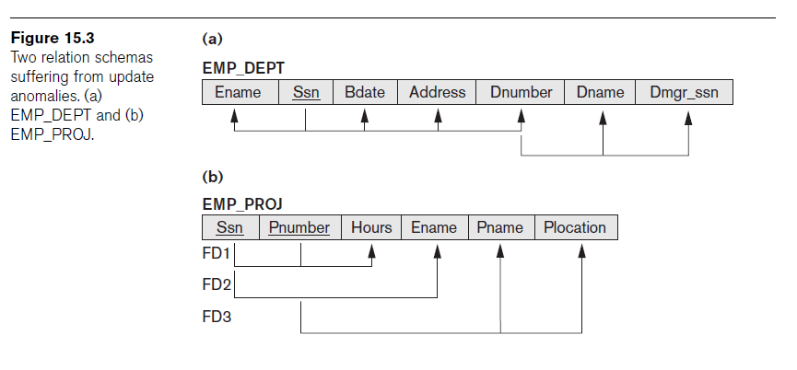
Example of violating Guideline 1

Slide 16
Informal Design Guidelines for Relation Schemas
Measures of quality
Making sure attribute semantics are clear
Reducing redundant information in tuples
Reducing NULL values in tuples
Disallowing possibility of generating spurious tuples

Slide 17
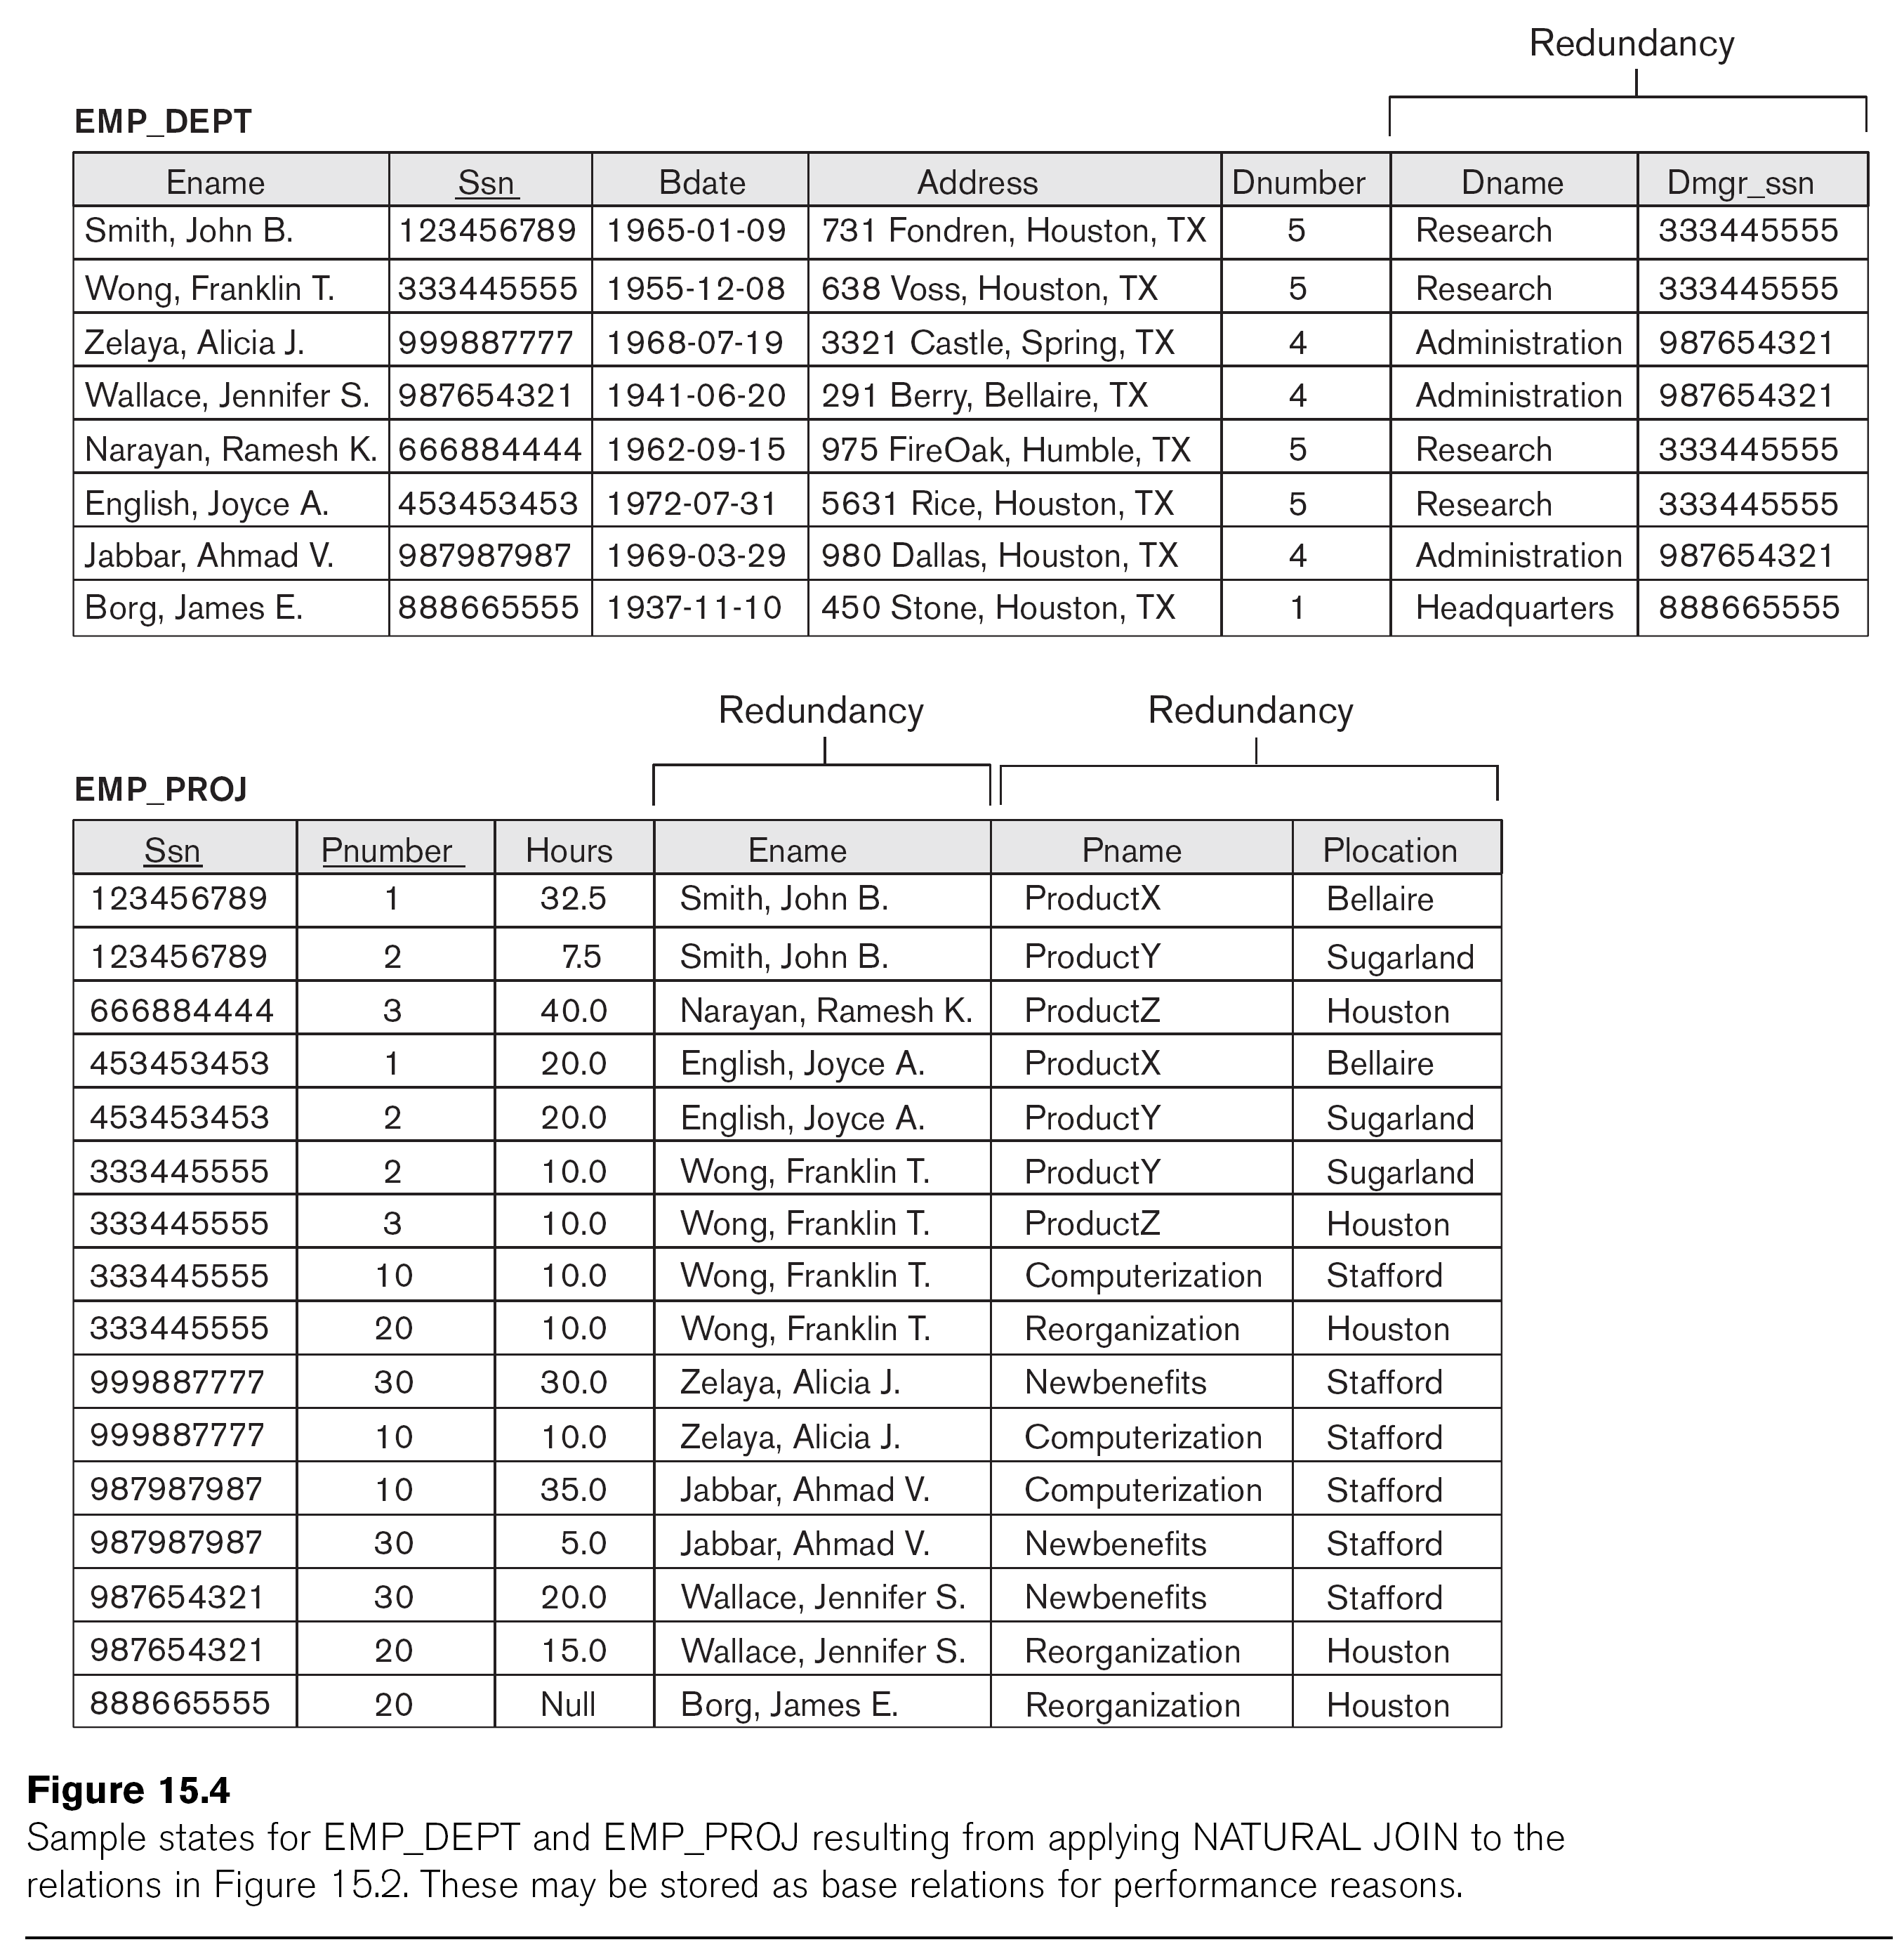
Redundant Information in Tuples and Anomalies
Grouping attributes into relation schemas
Significant effect on storage space
Storing natural joins of base relations leads to data anomalies
Types of data anomalies:
Insertion
Deletion
Update

Slide 18
Data Anomalies
Update anomaly
Insertion anomaly
Deletion anomaly
Can we modify the Dname of the 1st tuple of EMP_DEPT?
What if we want to insert a new department but does not have an employee in the department yet.
If we delete the employee Borg, James E., we lose information about the department 5!

Slide 19
Guideline 2
Design base relation schemas so that no data anomalies are present in the relations
If any anomalies are present:
Note them clearly
Make sure that the programs that update the database will operate correctly

Slide 20
Informal Design Guidelines for Relation Schemas
Measures of quality
Making sure attribute semantics are clear
Reducing redundant information in tuples
Reducing NULL values in tuples
Disallowing possibility of generating spurious tuples

Slide 21
NULL Values in Tuples
May group many attributes together into a “fat” relation
Can end up with many NULLs
Problems with NULLs
Wasted storage space
Problems understanding meaning

Slide 22
Guideline 3
Avoid placing attributes in a base relation whose values may frequently be NULL
If NULLs are unavoidable:
Make sure that they apply in exceptional cases only, not to a majority of tuples

Slide 23
Informal Design Guidelines for Relation Schemas
Measures of quality
Making sure attribute semantics are clear
Reducing redundant information in tuples
Reducing NULL values in tuples
Disallowing possibility of generating spurious tuples

Slide 24
Generation of Spurious Tuples
Figure 15.5(a)
Relation schemas EMP_LOCS and EMP_PROJ1
NATURAL JOIN
Result produces many more tuples than the original set of tuples in EMP_PROJ
Called spurious tuples
Represent spurious information that is not valid

Slide 25
Example: Spurious Tuples
Result of applying NATURAL JOIN to EMP_LOCS and EMP_PROJ1
Generated spurious tuples are marked by asterisks

Slide 26
Guideline 4
Design relation schemas to be joined with equality conditions on attributes that are appropriately related
Guarantees that no spurious tuples are generated
Avoid relations that contain matching attributes that are not (foreign key, primary key) combinations

Slide 27
Summary and Discussion of Design Guidelines
Anomalies cause redundant work to be done
Waste of storage space due to NULLs
Difficulty of performing operations and joins due to NULL values
Generation of invalid and spurious data during joins

Slide 28
Basic Functional Dependency and Normal Forms

Slide 29
Review Questions
Discuss insertion, deletion and modification anomalies. Why are they considered bad? Illustrate with examples.
State the informal guidelines for relation schema design that we discussed. Illustrate how violation of these guidelines may be harmful.

Slide 30
Normalization
Process for evaluating and correcting table structures to minimize data redundancies
helps eliminate data anomalies
Works through a series of stages called normal forms:
Normal form (1NF)
Second normal form (2NF)
Third normal form (3NF)
Boyce-Codd Normal Form
2NF is better than 1NF; 3NF is better than 2NF
For most business database design purposes, BCNF is highest we need to go in the normalization process
Highest level of normalization is not always most desirable

Slide 31
The Evils of Redundancy
Redundancy is at the root of several problems associated with relational schemas:
redundant storage, insert/delete/update anomalies
Integrity constraints, in particular functional dependencies, can be used to identify schemas with such problems and to suggest refinements.
Main refinement technique: decomposition
replacing ABCD with, say, AB and BCD, or ACD and ABD.
Decomposition should be used judiciously

Slide 32
Functional Dependencies (FDs)
X → Y means
Given any two tuples in r, if the X values are the same, then the Y values must also be the same. (but not vice versa)
That is, we cannot have two tuples with the same X value but different Y values.
Can read “→” as “determines”
note that this symbol (and its meaning) is different than the one for logical implication!!!
Constraints on the set of legal relations.
Require that the value for a certain set of attributes determines uniquely the value for another set of attributes.
A functional dependency is a generalization of the notion of a key.

Slide 33
ER Model and Normalization
When an E-R diagram is carefully designed, identifying all entities correctly, the tables generated from the E-R diagram should not need further normalization.
However, in a real (imperfect) design, there can be functional dependencies from non-key attributes of an entity to other attributes of the entity
Example: an employee entity with attributes department_name and building, and a functional dependency department_name→ building
Good design would have made department an entity

Slide 34
Denormalization for Performance
May want to use non-normalized schema for performance.
Pros and Cons?
Faster lookup
Data anamalies
Extra space and extra execution time for updates
Extra coding work for programmer and possibility of error in extra code

Slide 35

Thank you.
Exit Slip:
Discuss 3 important things / concepts we have learned today.

